Slide 1
AUTONOMOUS CROSS-SECTION MANAGEMENT
GROUP: PARIS
ADITYA KUMAR, WIKTOR KOCHANEK, GORDAN KONEVSKI
HOCHSCHULE HAMM-LIPPSTADT, ELECTRONIC ENGINEERING 2022

Slide 2
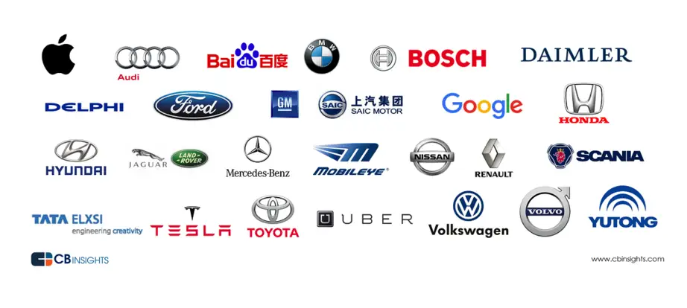
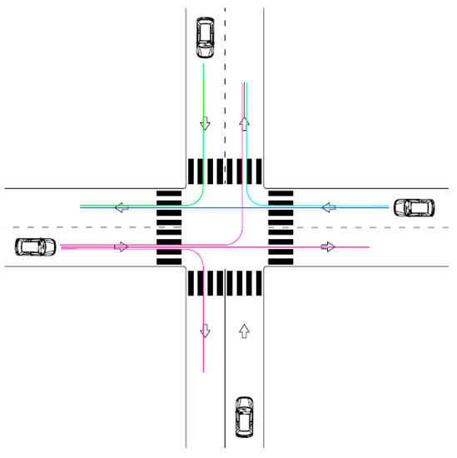
Motivation & Introduction

Slide 3
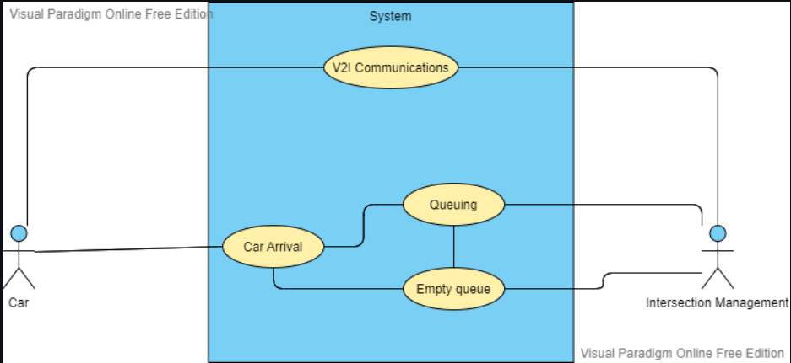
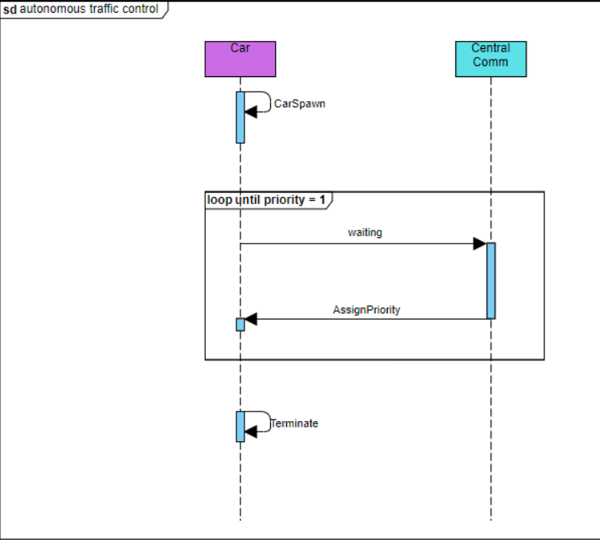
UML Diagrams

Slide 4

UPPAAL Implementation
None of the demos use a clock, since it would have been a redundant element to a First Come First Serve model.
Note 1:
Item 2
Note 2:
This model is intended to be used as a reference point to its FreeRTOS alternative and is not representative of the final algorithm.

Slide 5
UPPAAL implementation demo…

Slide 6
Hardware Implementation
Collision avoidance
Main motivator - safety

Slide 7
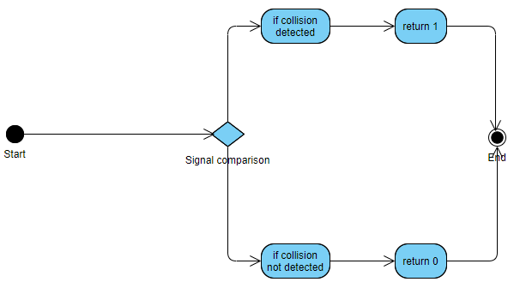
What does it do
Cars communicate path to each other
Our implementation checks for possible collision
Response based on output

Slide 8
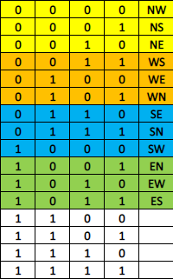
How does it do it
Defining a path
4-bit signals
Each signal defines one path
U-turn path excluded, but can be added
Cardinal directions don’t represent the true directions

Slide 9
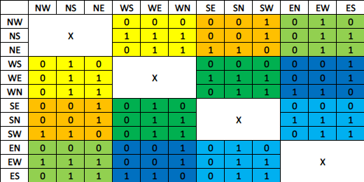
How does it do it, cont.
Collision truth table
Compares signals from 2 cars
X sections are same paths for 2 cars
Detected collisions return 1, otherwise 0

Slide 10


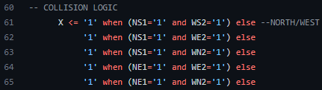
How does it do it, cont.
Code fragments
Signals for both cars need to be defined
Car 1 singal ABCD, directions 1
Car 2 signal EFGH, directions 2
Collision logic using “when/else” statements
X is the output
Only 1’s are defined, other cases return 0

Slide 11
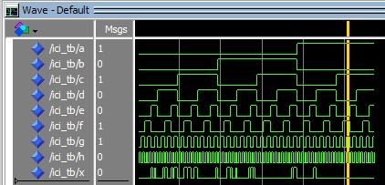
Testbench
Car 1 signal considered static
Then, is compared to all Car 2 signal possibilities
Increment Car 1 signal, repeat
Safety in mind
Tests duplicate pairs
Tests unused signals

Slide 12
Software Implementation
Key Elements:
Vehicle data
Vehicle spawn
Scheduler
Resolver

Slide 13
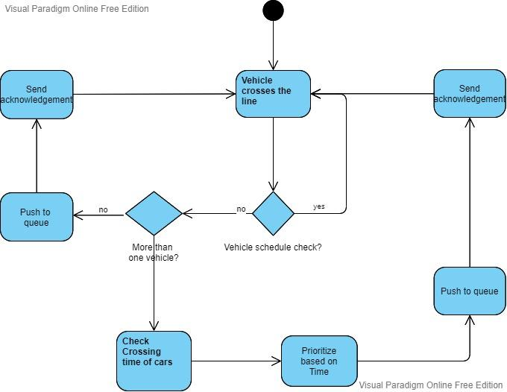
Activity Diagram Scheduler

Slide 14
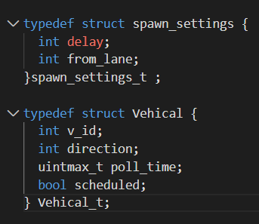


Slide 15
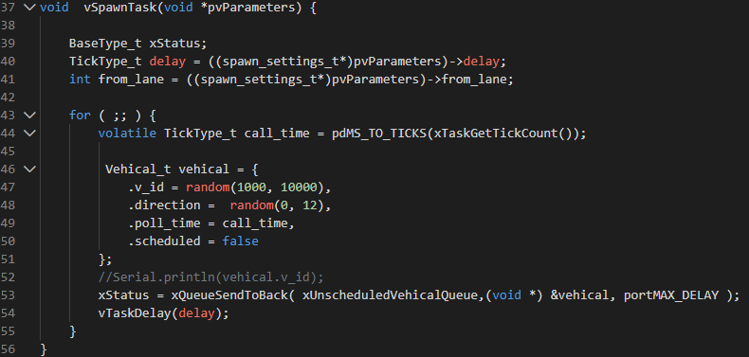
Function : To spawn vehicles

Slide 16
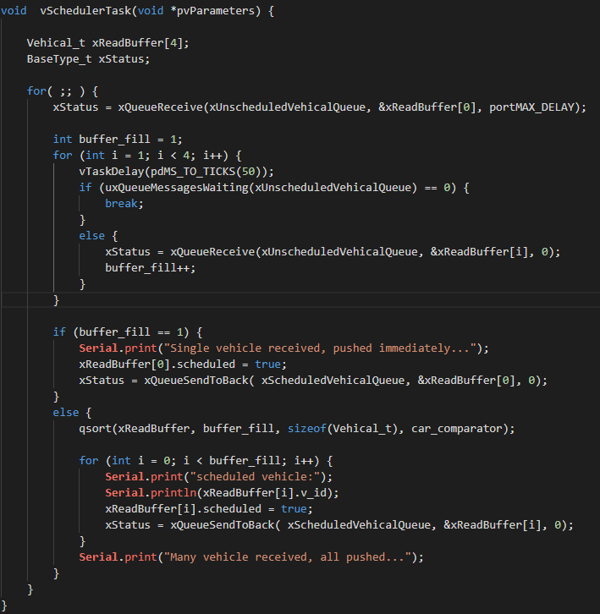
Function : To Schedule vehicle

Slide 17
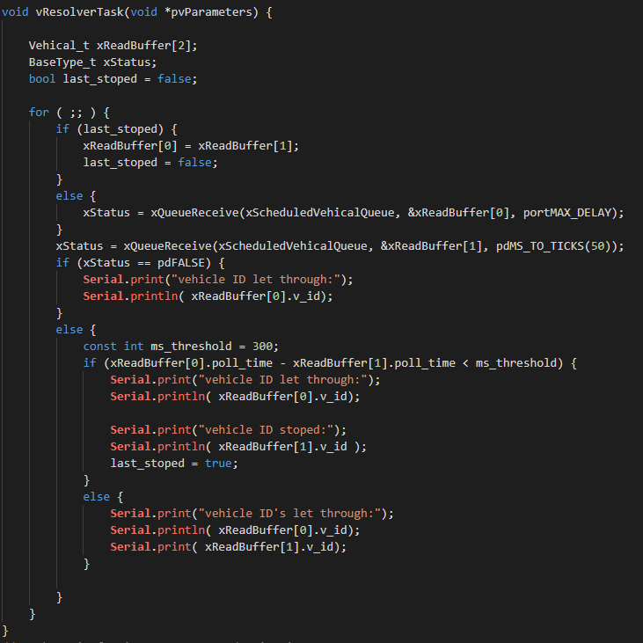
Function : To let vehicle through

Slide 18
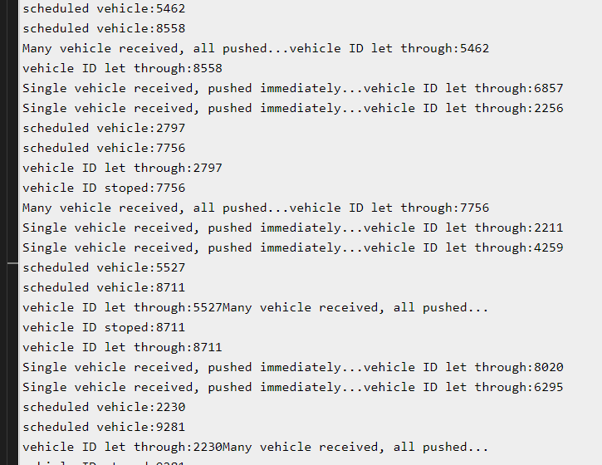
Serial Monitor

Slide 19
Conclusion
Uppaal implementation - demonstration of First Come First Serve model
Hardware implementation - collision avoidance model
Software implementation - FreeRTOS complete and final demonstration of the algorithm
“Less is more”
–Robert Browning

Slide 20
Material Used:
https://www.facebook.com/uppaal/photos/a.478706870742/267869850742/
https://www.businessinsider.com/30-companies-are-now-making-self-driving-cars-2016-4
https://www.mdpi.com/applsci/applsci-10-00316/article_deploy/html/images/applsci-10-00316-g017-550.jpg

